Slide 1
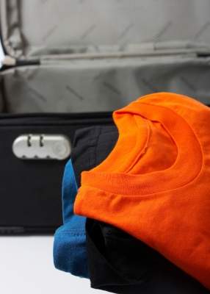
P2 project Bag Packer Program
Made by:
Christian J. O’Keeffe
Rasmus F. Gadensgaard
Aleksander S. Nilsson
Kasper Plejdrup
Dag T. B. Pedersen
Mette T. Pedersen
Niels B. Pedersen

Slide 2
Content of presentation
Problem Analysis
Theory
Design
Development
Testing
Discussion & Conclusion
Process Analysis

Slide 3
Initializing problem
People can’t pack a suitcase properly
Notes:
Meetski

Slide 4
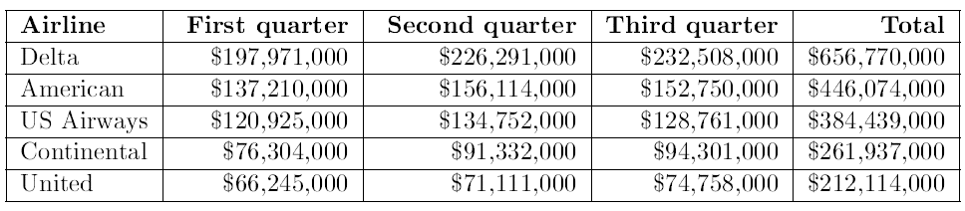
Documentation of problem
People get fees for having overweight in their suitcases
Notes:
Meetski

Slide 5
Solutions on the Market
Product:
App - Packing Pro
Online check/tip list
The e-Commerce shipping calculator
Purpose of looking at existing solutions
Notes:
Alexandrius

Slide 6
Problem Statement
“How can a program be developed which helps the customer through the process of packing one or more suitcases the most effective way by size and weight?”
Substatements
Notes:
Alexandrius

Slide 7
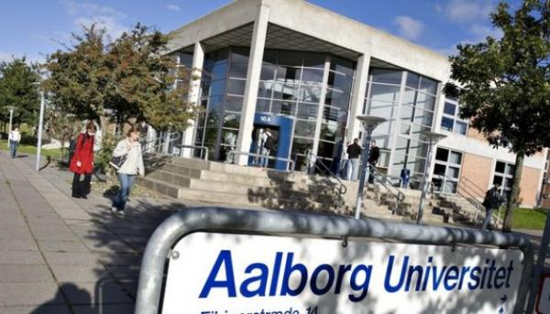
Method
Work by the Aalborg PBL model.
Source criticism
Notes:
Alexandrius

Slide 8


Bin Packing Problem
What is the bin packing problem?
Example of bin packing in 1D
Knapsack Problem
Notes:
Niller

Slide 9
Specification Requirements
Targeted Features
Guide the User
Distribute Weight
Distribute Space
On the Road
Baggage Rules
Structure of Packing
Packing list
Save/Load function
Notes:
Niller

Slide 10
Solution suggestions
Application for smartphones
Extension for an existing program
Program for the computer
Choice of solution
Notes:
Niller

Slide 11

Demonstration of program
Notes:
Kappers

Slide 12
Different function description
The packing algorithm
Color assignment function
How the program handles 3D
Function to draw cubes
Notes:
Christian den store

Slide 13
Packing Algorithm
Goal of packing algorithm
SPØRG KARSTEN OM Flowchart
Notes:
Christian den store

Slide 14
Color Assignment Function
Notes:
Razz

Slide 15
How the program handles 3D
Notes:
Razz

Slide 16
Testing
Choice of Survey Method
The First Round of Tests
The Second Round of Tests
Conclusion
Unit Tests
Notes:
Daine

Slide 17
Discussion
Discussion
Perspectivation
Notes:
Daine

Slide 18
Conclusion
Notes:
Daine

Slide 19
Process Analysis
Project planning
Group Work
Collaboration with Supervisors
Process of Learning
Discussion and Putting Things into Perspective
Conclusion
Notes:
Kappers

